Slide 1
Hypothesis Testing
Is there a home court advantage in basketball?

Slide 2
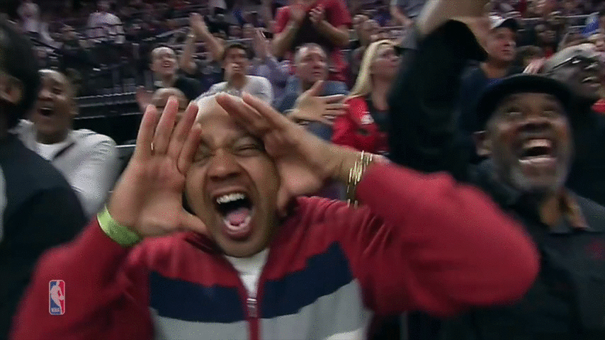
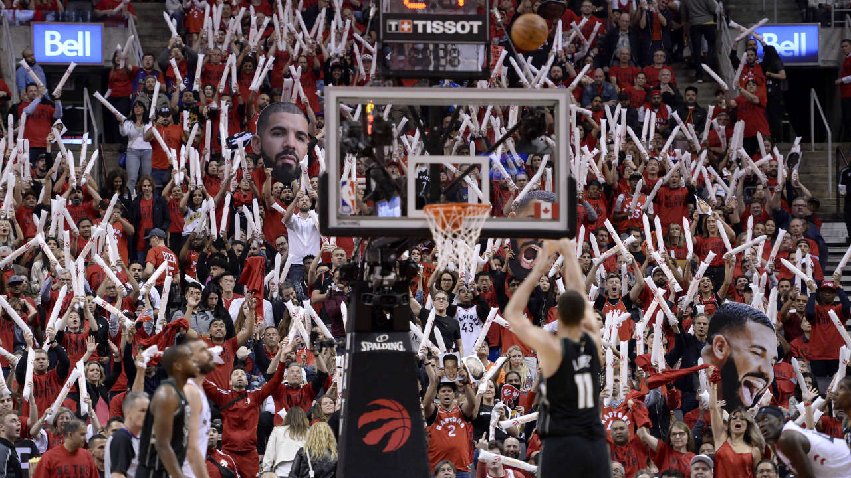

Home Court Advantage
In a typical year, home teams win 60% of NBA games
Sportsnet
Sports Illustrated

Slide 3
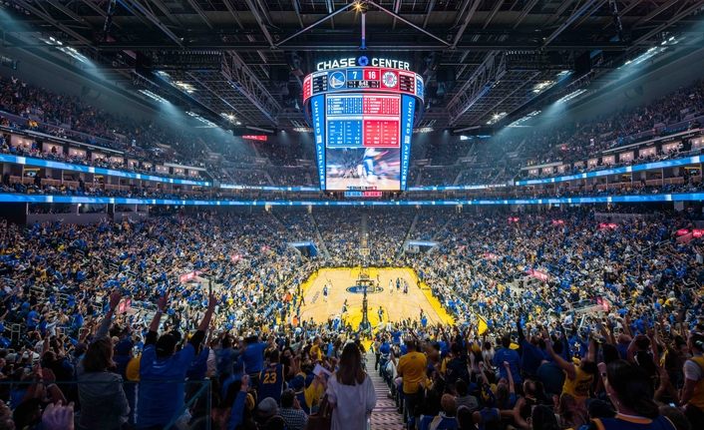
March 11, 2020
Photo from Live Production

Slide 4
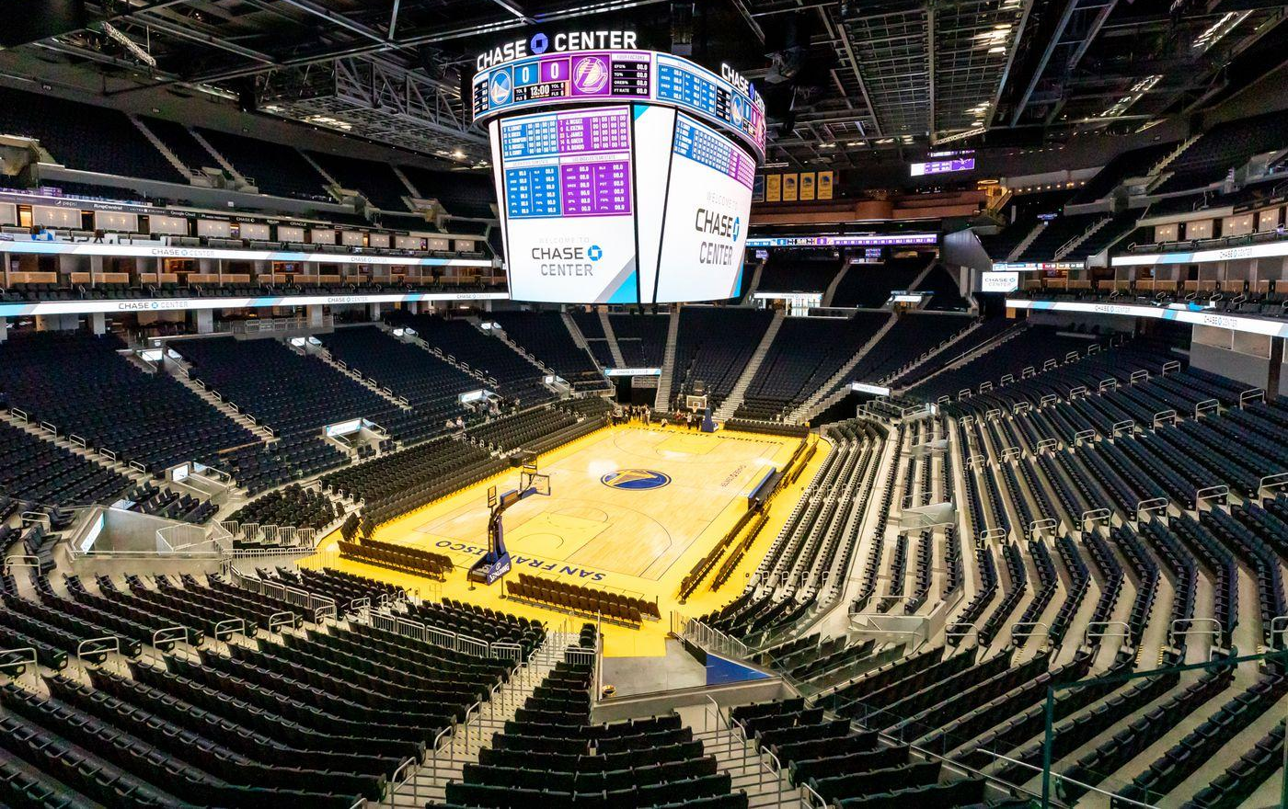
March 12, 2020
Image from Curbed San Francisco

Slide 5

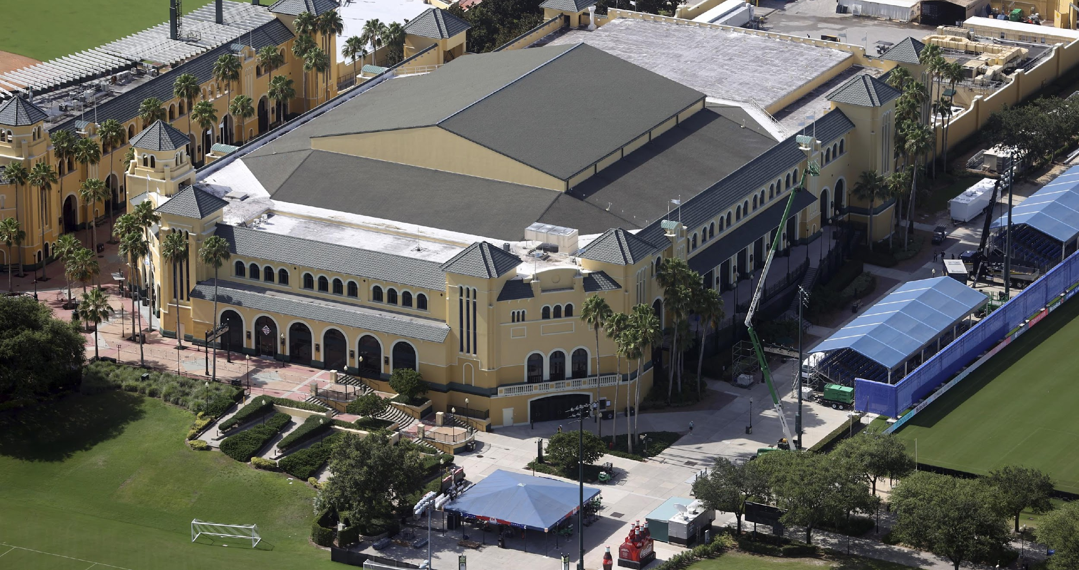

Summer 2020:
The NBA Bubble
(at Disneyworld)
Image from Sporting News

Slide 6
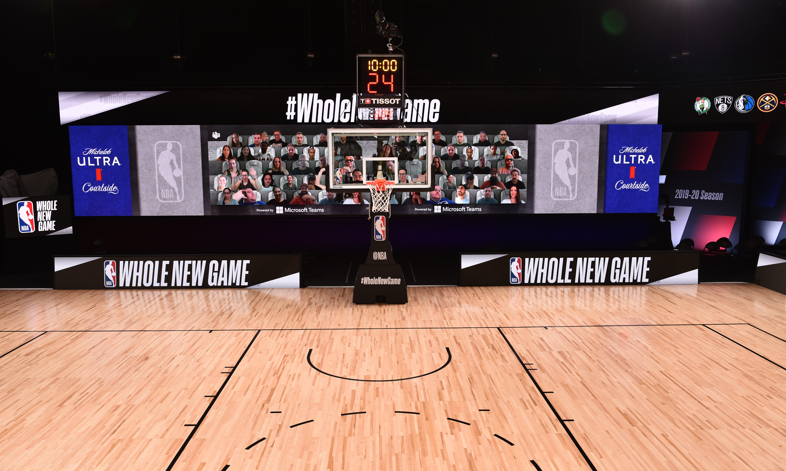
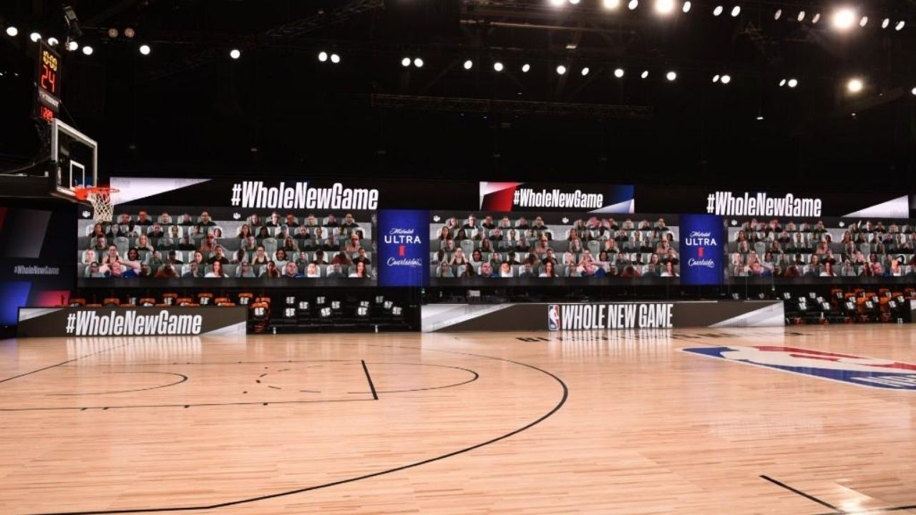
Empty Neutral Court
Images from USA Today

Slide 7
How the bubble worked:
22 teams
Each played 8 games to finish season
“Home” and “Away” designations randomly assigned for each game

Slide 8
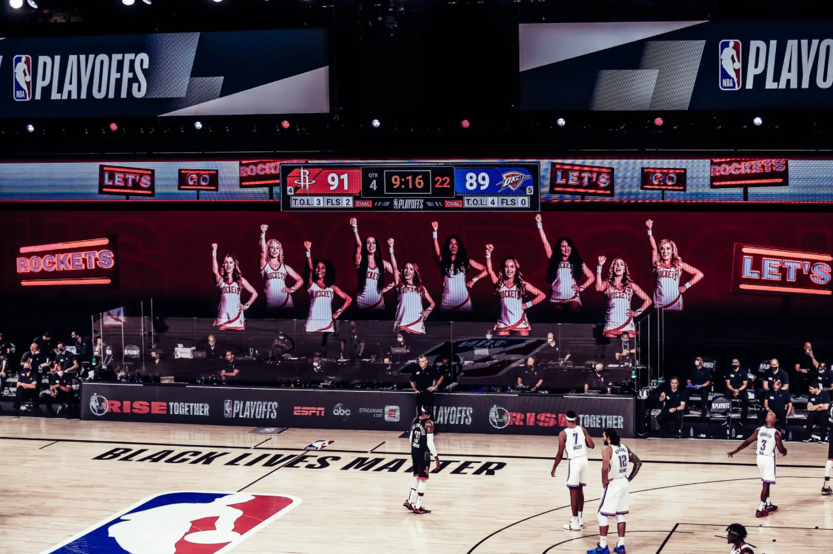
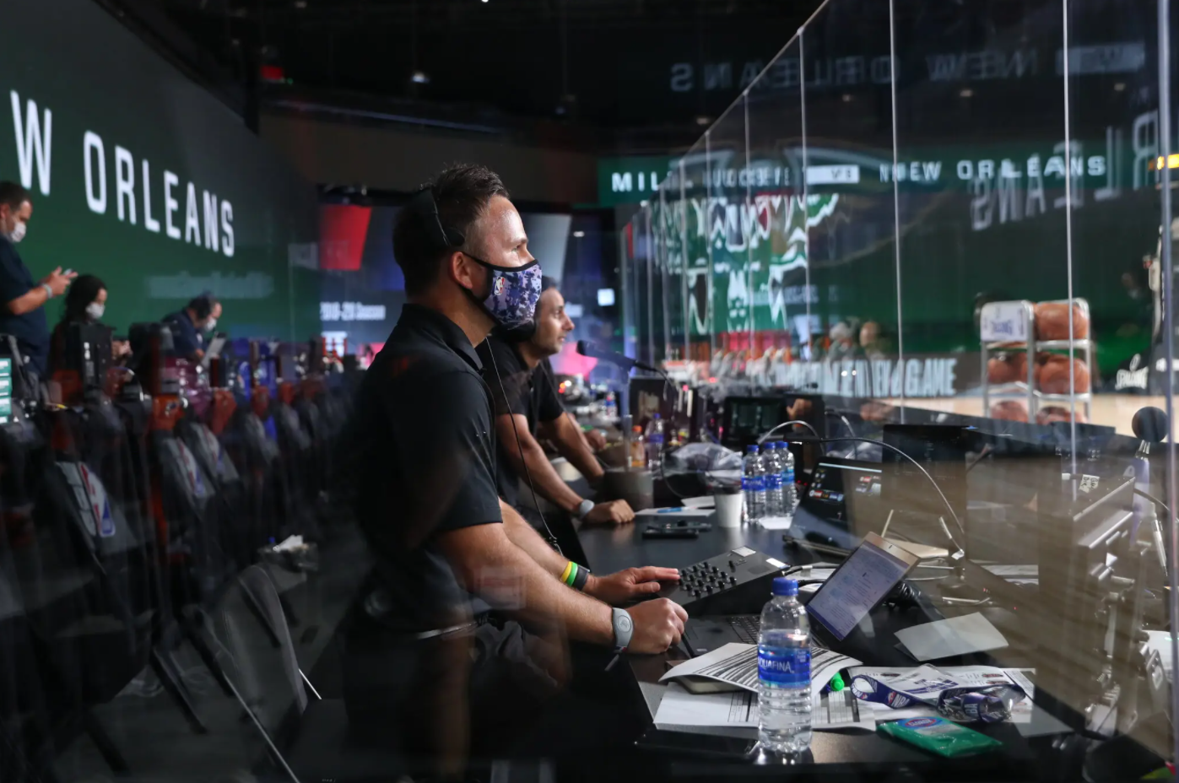
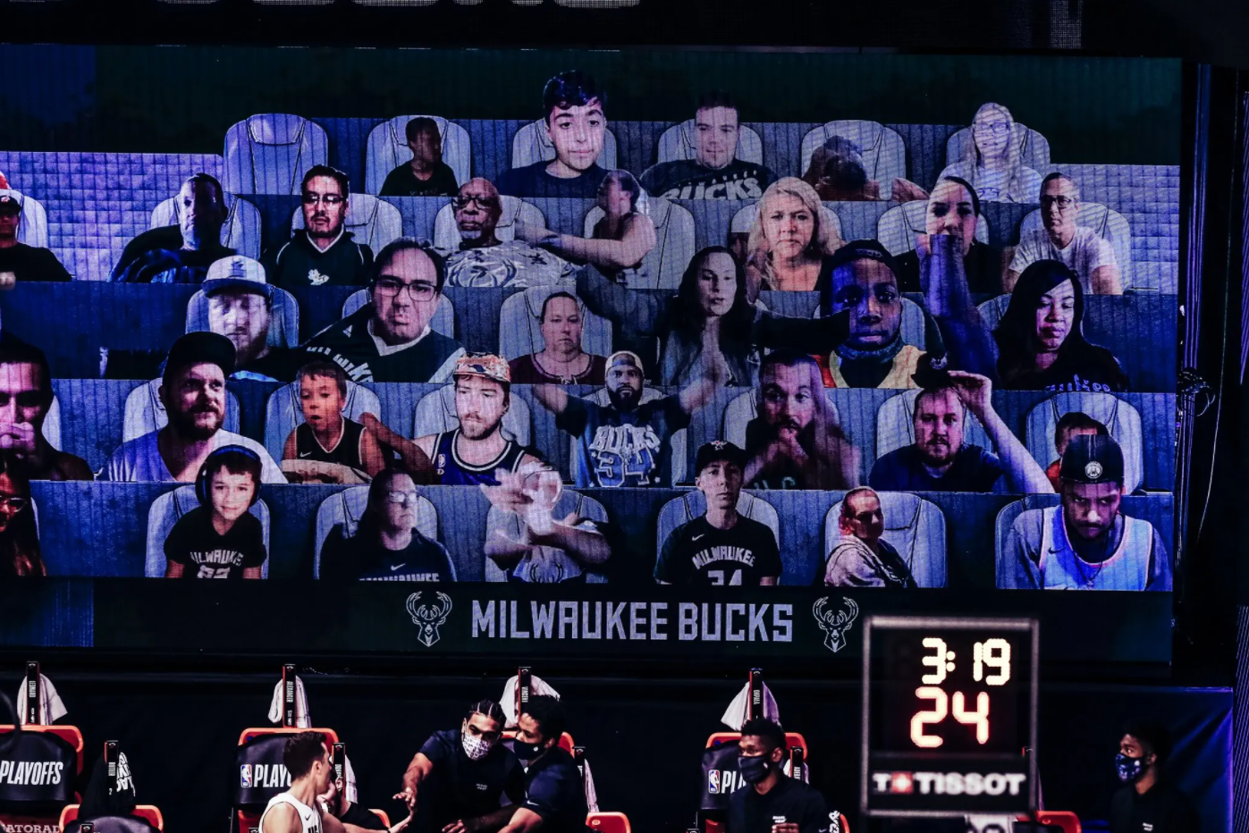
“Home” in the bubble
Images from The New York Times
Virtual cheerleaders
Livestream fans
Home stadium sounds

Slide 9
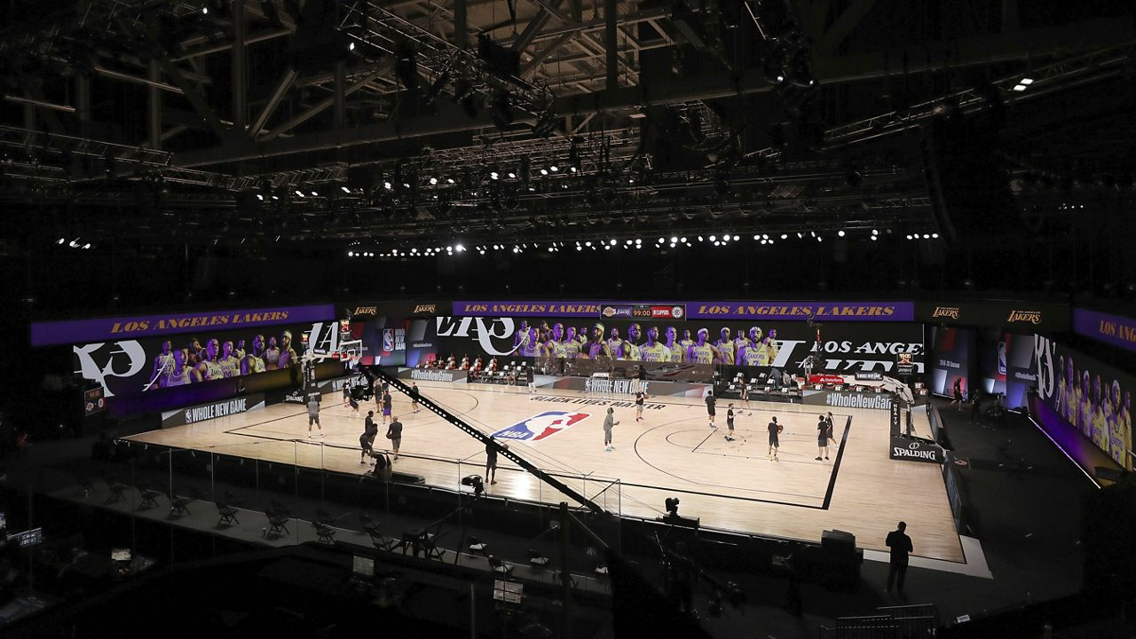
Was it enough to make up for the lack of 20,000 screaming fans?

Slide 10

In the bubble…
The teams randomly assigned to be “home” won 49 (56%) times.
Image from GSW / Twitter

Slide 11
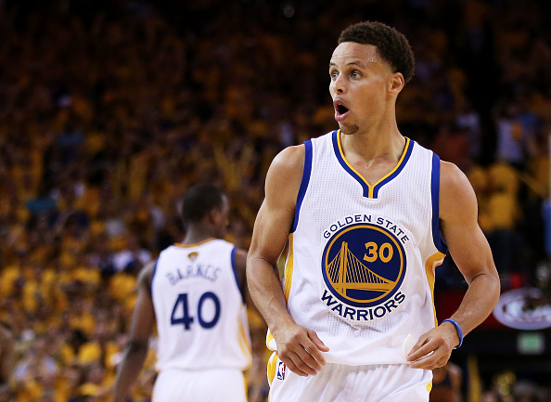
In the bubble…
The teams randomly assigned to be “home” won 49 (56%) times. The “away” teams won only 39 (44%) times.
Image from Basketball Forever

Slide 12
In the bubble…
The teams randomly assigned to be “home” won 49 times. The “away” teams won only 39 times.
Today’s Key Analysis
Did “home” teams have a real advantage in the bubble?
Image from Basketball Forever

Slide 13

Hypothesis A
There was no true home team advantage in the bubble. Homes teams won more often by chance alone.

Slide 14
Hypothesis B
There was a home team advantage in the bubble. Homes teams won more often because they had a true advantage.
Images from The New York Times

Slide 15
Hypothesis A: No true home court advantage
Hypothesis B: True home court advantage
Before we do any analysis, which hypothesis would you assume to be true? Why?

Slide 16
Hypothesis A: No true home court advantage
Hypothesis B: True home court advantage
Before we do any analysis, which hypothesis would you assume to be true? Why?
Hypothesis A – it’s a neutral court and there aren’t even fans in the stands!

Slide 17
Hypothesis A: No true home court advantage
Null Hypothesis
“Dull” Hypothesis: Nothing interesting is happening
Assume it to be true
Hypothesis B: True home court advantage
Alternative Hypothesis
Usually the hypothesis we think of first

Slide 18
Hypothesis A: No true home court advantage
Null Hypothesis
“Dull” Hypothesis: Nothing interesting is happening
Assume it to be true
Hypothesis B: True home court advantage
Alternative Hypothesis
Usually the hypothesis we think of first
Is there enough evidence to “reject” the null hypothesis? We are not trying to prove the
alternative hypothesis.

Slide 19
Null Hypothesis: No true home court advantage
In a world where there is no home court advantage, what proportion (percentage) of games would we expect home teams to win?

Slide 20
Null Hypothesis: No true home court advantage
In a world where there is no home court advantage, what proportion (percentage) of games would we expect home teams to win?
50%

Slide 21
What we observed:
Of the 88 games played, the home teams won 49 times (56% of the games)

Slide 22
Our Question: In a world where there is no home court advantage, what are the chances that home teams win 49 or more of the 88 games played?

Slide 23
Our Question: In a world where there is no home court advantage, what are the chances that home teams win 49 or more of the 88 games played?
In this world, every game is like a coin flip! (p = 0.5)

Slide 24
NOW TO NOTEBOOK 4

